Slide 1
DSF-PT04B
Central Limit Theorem
Discover. Grow. Transform

Slide 2
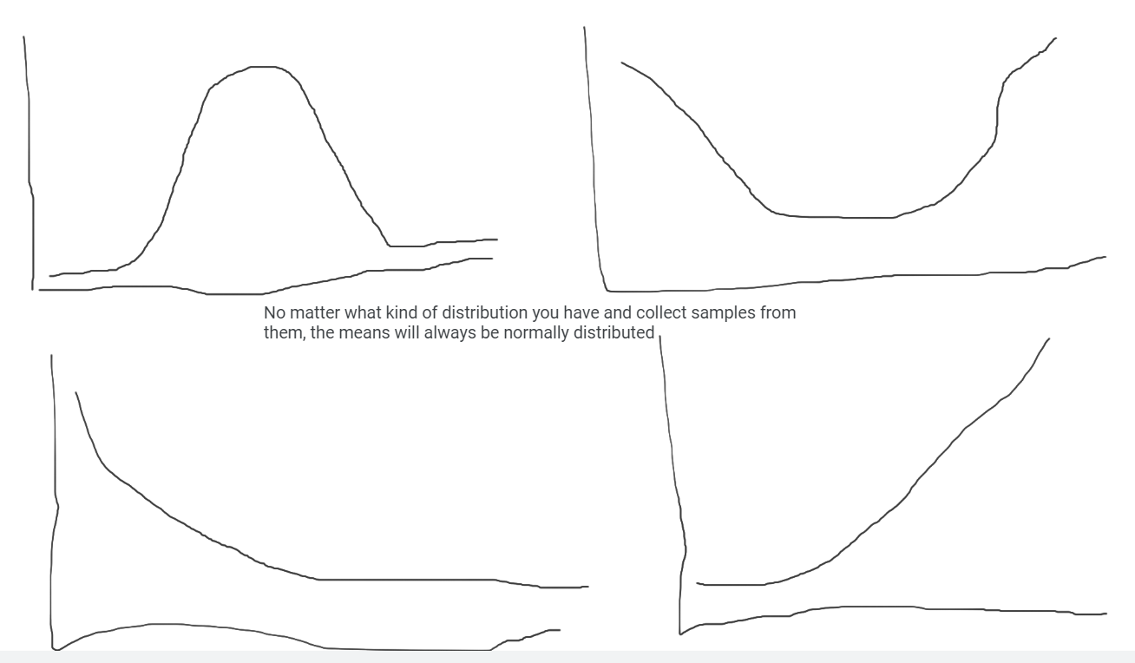

Slide 3
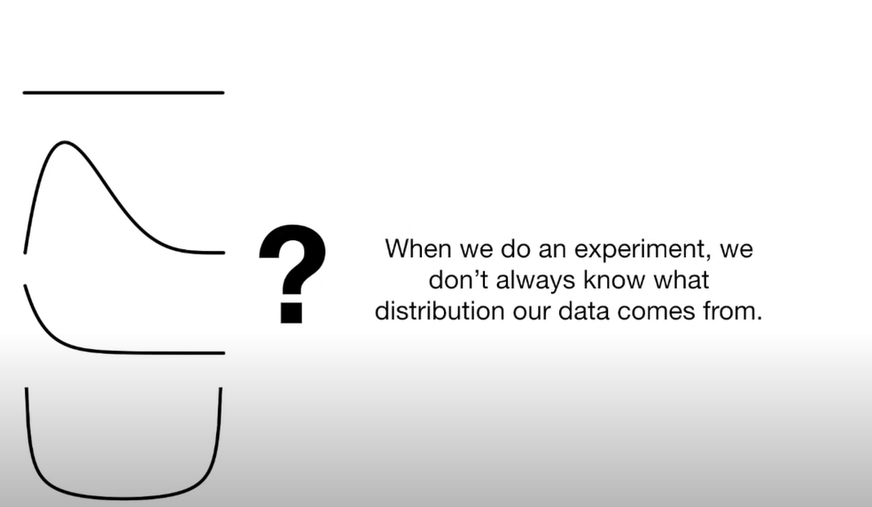
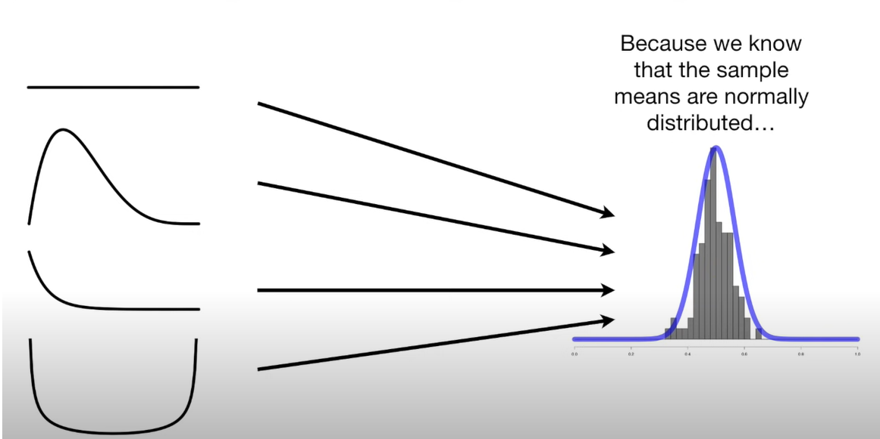
The Exponential Distribution Curve
Soft Skills
Notes:
The exponential distribution is a right-skewed continuous probability distribution that models variables in which small values occur more frequently than higher values. It is a unimodal distribution where small values have relatively high probabilities, which consistently decline as data values increase.
The Sample size must be atleast 30, this rule can be broken. The Cauchy distribution is the only that doesn’t have a mean but it is very rare

Slide 4

Managing Uncertainty when reporting Numbers
Notes:
Inference is when we draw conclusions about the population based on a sample/samples
Sampling Error/ Variation due to Sampling
Estimates
What affects the widths of confidence intervals? Variation within the population of interest (small variation means a small confidence interval meaning that the mean would be very close to that of the true population II Then two, the Size of the Sample( Population with lots of variation leads to varied samples with higher variation and hence a wider confidence interval.
The effect of sampling error is reduced with larger samples
https://www.youtube.com/watch?v=tFWsuO9f74o
https://www.youtube.com/watch?v=s4SRdaTycaw

Slide 5
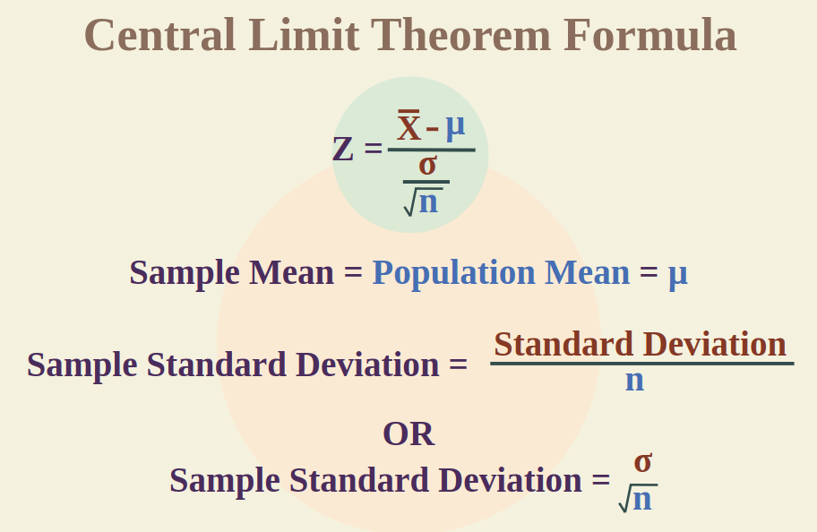
Notes:
What is

Slide 6

Central Limit Theorem
Notes:
The Central Limit Theorem allows us to treat non-normal distributions as normal distributions, and provides a way for us to estimate parameters about a population.

Slide 7
The Jar Example
Imagine you have a big jar of colorful marbles, and you want to know the average (middle) size of those marbles. But it's too hard to measure all of them, so you decide to pick out a handful of marbles and measure them
Now, here's where confidence intervals come in. Instead of saying, "The average marble size is exactly 3 centimeters," we say, "We think the average marble size is around 3 centimeters, and we're pretty sure it's somewhere between 2.5 and 3.5 centimeters."
That range from 2.5 to 3.5 centimeters is like a confidence interval. It tells us that we're quite confident that the average marble size is within that range, but we're not 100% certain because we didn't measure all the marbles.
So, confidence intervals help us give a good guess about something, like the average marble size, and they show how sure we are about our guess. It's like making a smart guess without being absolutely sure, just like when you estimate the number of candies in a jar without counting every single one.

Slide 8
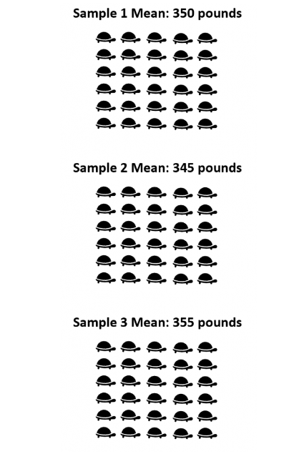
Central Limit Theorem in relation to Sampling
Variability in Sampling: When you take random samples from a population, the sample means (average values) tend to vary. Some samples might have higher means, while others might have lower means. This variation is natural because different samples will have different individuals or data points.
Soft Skills

Slide 9
Central Limit Theorem in relation to Sampling
Central Limit Theorem: The Central Limit Theorem states that if you were to take many random samples from a population and calculate the means of each of those samples, the distribution of those sample means will approximate a normal distribution (bell-shaped curve), regardless of the shape of the original population distribution. This is true as long as the sample size is sufficiently large, typically around 30 or more
Usefulness: The Central Limit Theorem is incredibly useful because it allows us to make statistical inferences about a population based on sample data. Since the sample means follow a normal distribution, we can use properties of the normal distribution to make probabilistic statements and perform hypothesis testing, even when we don't know the exact shape of the population distribution.
Applications: It's widely applied in various fields, from quality control in manufacturing to political polling and medical research. For example, if you want to estimate the average height of all people in a country, you can take random samples of different groups of people, calculate the means in each sample, and use the Central Limit Theorem to make confident statements about the range in which the true average height likely falls.
Soft Skills

Slide 10
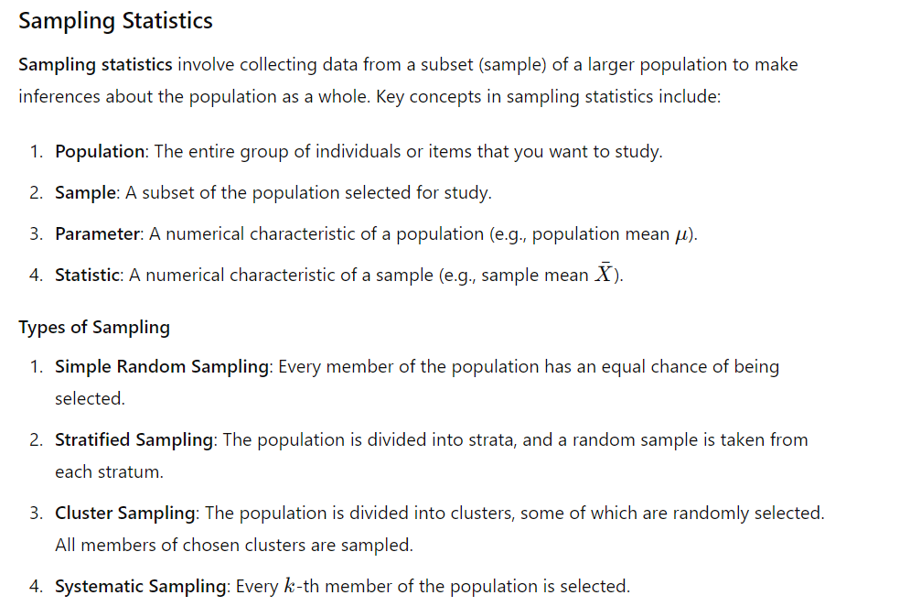
Notes:
There are two methods by which this sampling error can be reduced: Increasing sample size, Stratification

Slide 11
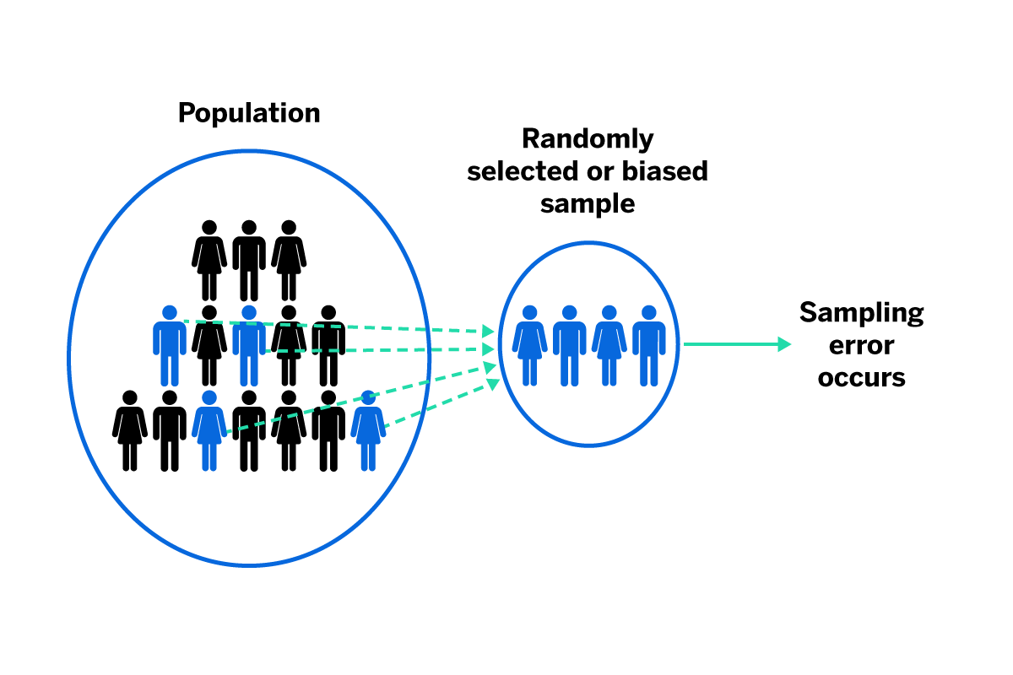
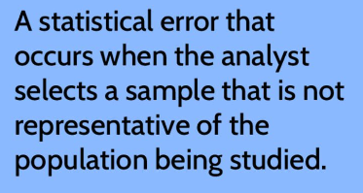
The Sampling Error
Notes:
Causes

Slide 12
Sample Distribution:
Definition: The sample distribution refers to the distribution of values within a single sample that you've taken from a population. In other words, it shows how data points are distributed within a specific subset of your data, such as the characteristics of the people in a single survey or the measurements from a specific batch of products.
Purpose: It is used to describe the variability and patterns within a sample itself.
Sampling Distribution:
Definition: The sampling distribution, on the other hand, is a theoretical distribution that describes the behavior of a statistic (like the sample mean or sample proportion) across multiple samples of the same size drawn from the same population. In other words, it tells you how a particular statistic varies when you repeatedly take samples from the same population.
Purpose: The sampling distribution is essential for making statistical inferences about a population.
Notes:
Causes

Slide 13
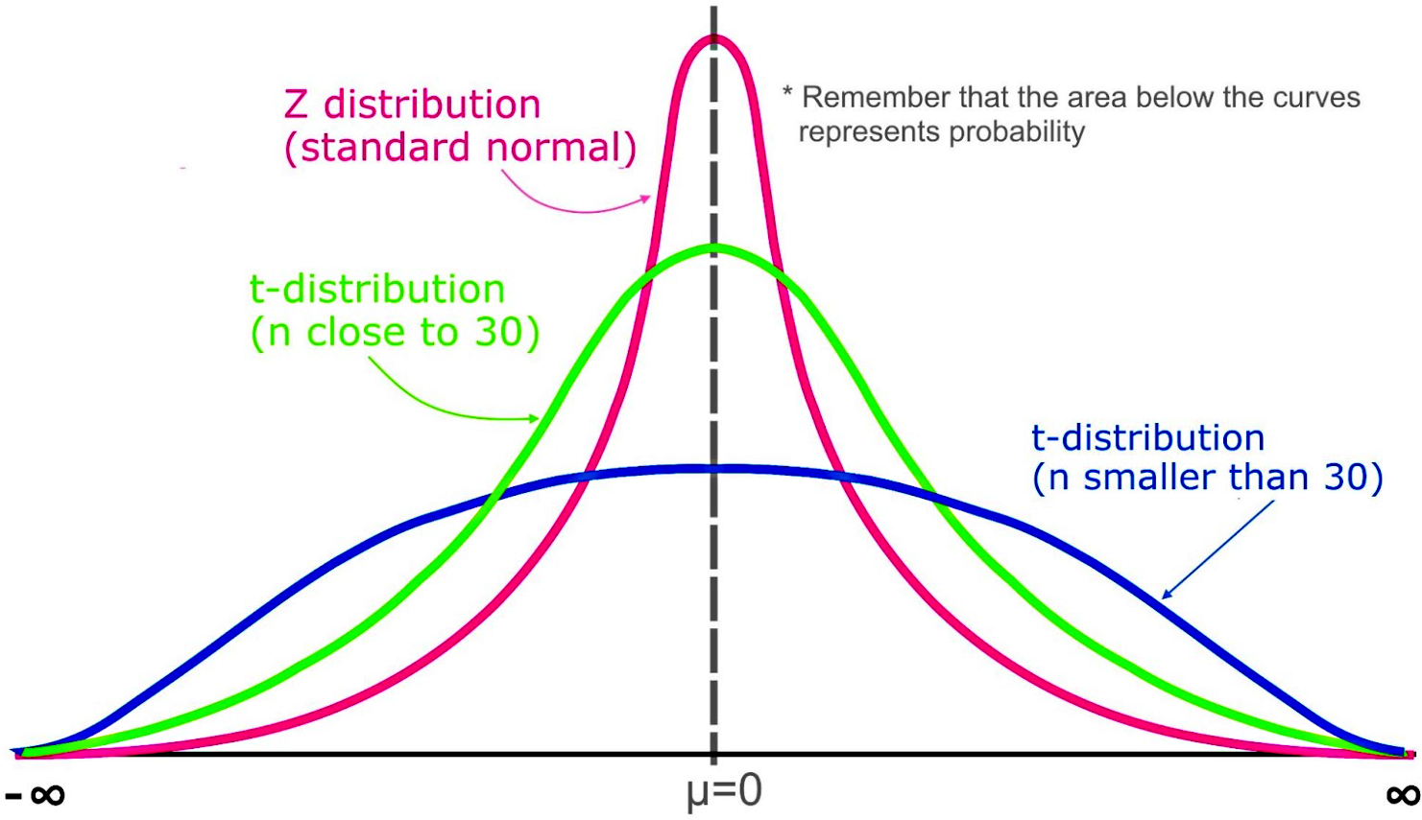
The t-Distribution
Notes:
Initial confidence intervals we'll construct will use the z-distribution introduced previously.
This technique is somewhat limited because it requires that we know the standard deviation of the population.
The t-distribution allows us to work with samples where the population standard deviation is unknown (as well as smaller samples), in order to form confidence intervals.

Slide 14
Thank You!

